Slide 1

PlaatEnergy (Energy Data Logger) Open Source Project
W.B.J. van der Plaat
(Principal IT Architect)

Slide 2

Questions
How many energy is my house consuming daily?
How many gas is my heater consuming daily?
How many energy is my solar system deliver daily?
How many solar power is directly consumed by my house?

Slide 3


Idea
Lets create an application which measure everything
Create user friendly Web GUI
Use low cost, low energy hardware

Slide 4
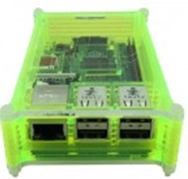
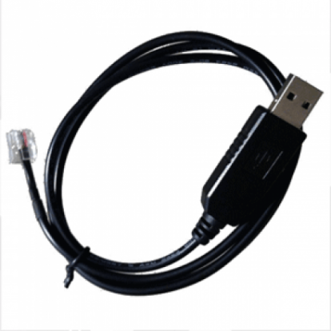

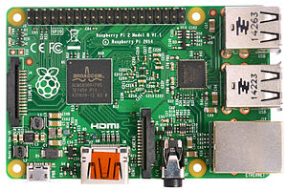

Used Hardware
Raspberry Pi 3B
USB to P1 Cable
Micro SD card (16GB)
USB power supply
Raspberry Pi Case

Slide 5



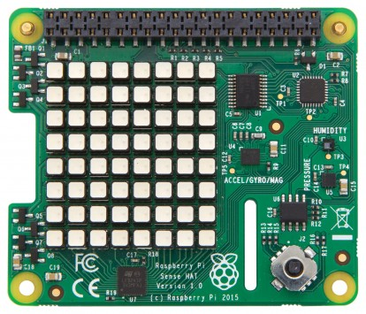
Optional Hardware
Wifi USB Dongle
Bluetooth USB Dongle
Pi Sense Hat
Unicorn Hat

Slide 6

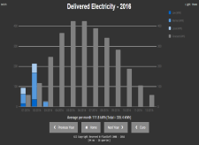



Hardware View – Configuration 1
HDMI
Omnik Solar
Converter
Raspberry Pi
PlaatEnergy
Pi Sense Hat
Wifi
Wifi Router
Ethernet
USB
USB

Slide 7

Hardware View – Configuration 2
P1 cable
Digital Energy
Meter
Bluetooth
Digital Gas
Meter
Omnik Solar
Converter
USB
Raspberry Pi
PlaatEnergy
Sense Hat
Wifi
Wifi Router
Ethernet
Ethernet
ADSL Router
PlaatEnergy
Reachable on
internet
Ethernet
Internet

Slide 8
Hardware View – Configuration 3
P1 cable
Digital Energy
Meter
Bluetooth
Digital Gas
Meter
Hosola Solar
Converter
Hosola Solar
Converter
Hosola Solar
Converter
USB
Raspberry Pi
PlaatEnergy
Unicorn hat
Wifi
Wifi
Wifi
Wifi Router
Ethernet
Ethernet
PlaatEnergy
Reachable on
internet
ADSL Router
HDMI
PlaatEnergy
slide show
at
monitor
Ethernet
Internet

Slide 9
PlaatEnergy Software Architecture
Google Charts
Weather Service
WS / JSON
Presentation Layer
PHP/CSS/JS
Apache
Business Logic Layer
PHP
Database Layer
MySQL
Solar Converter
Interface
Energy Meter
Interface
Environment
Interface
Display
Interface
PHP/ Python
Operating
System
Debian Linux
Vendor Support
Omnik
Hosola
Vendor support
Kaifa
Landis
kamstrup
Vendor support
Pi onboard
Pi Sense Hat
Vendor support
Pi Sense Hat
Unicorn Hat

Slide 10
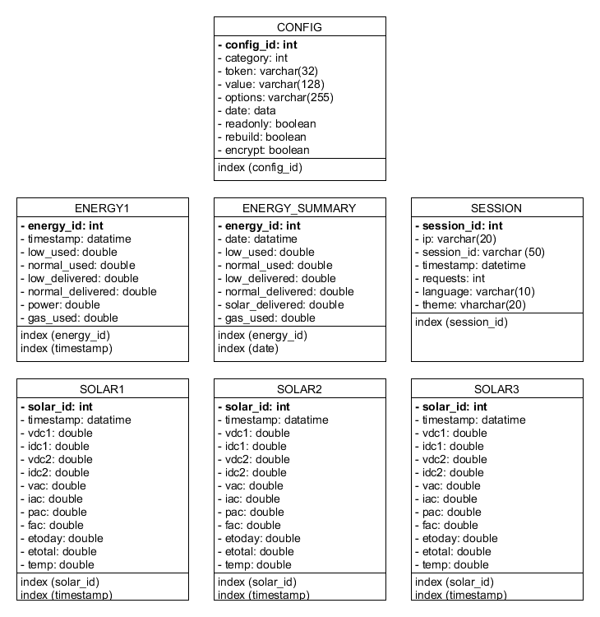
PlaatEnergy Data Model

Slide 11
PlaatEnergy Key Features
Measure each device every minute
Easy to use web interface
Show real-time, historical and forecast data
Show financial data
Support measurement corrections
Export measure data to CSV or SQL
Secure access to Web GUI and settings
Open Source project. So free to use!

Slide 12
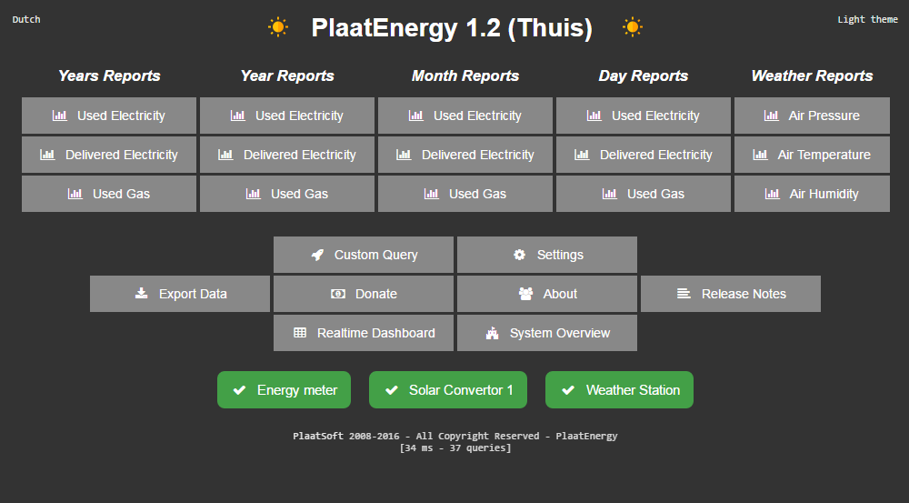

Slide 13
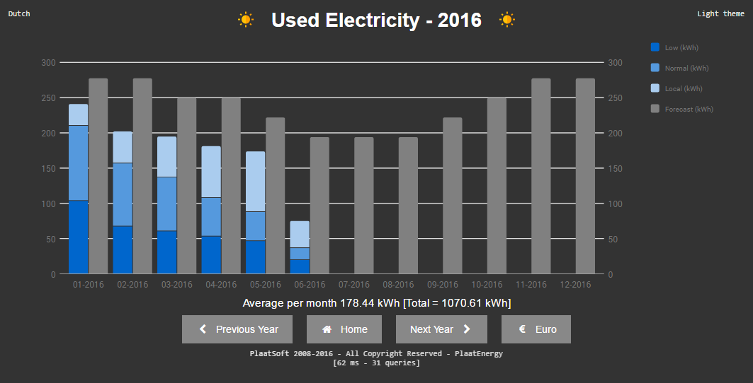

Slide 14
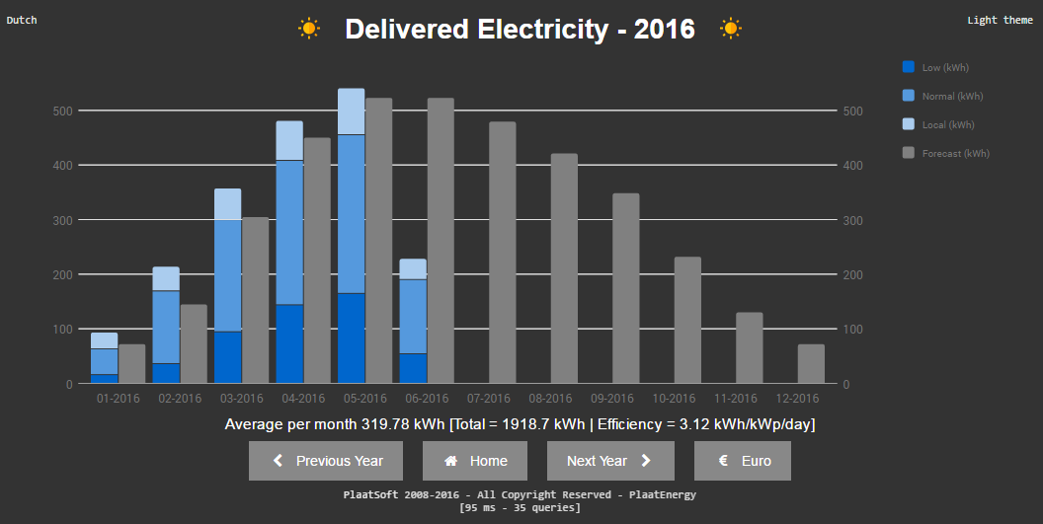

Slide 15
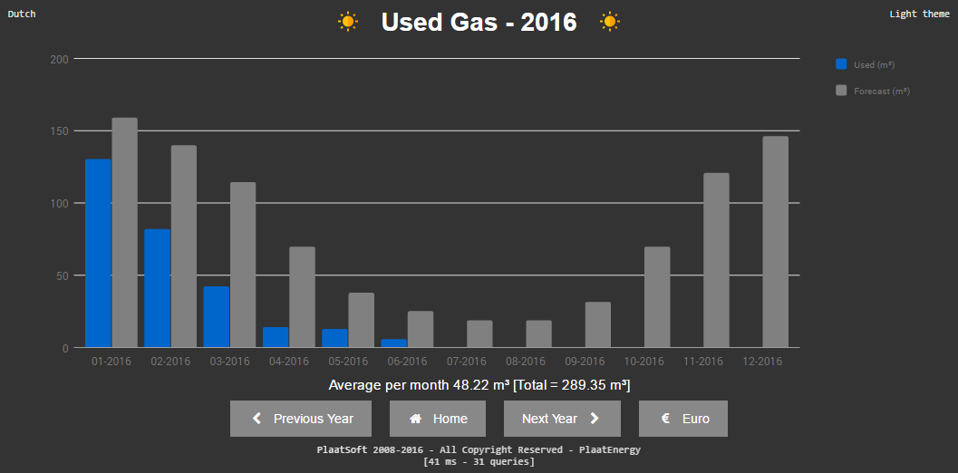

Slide 16
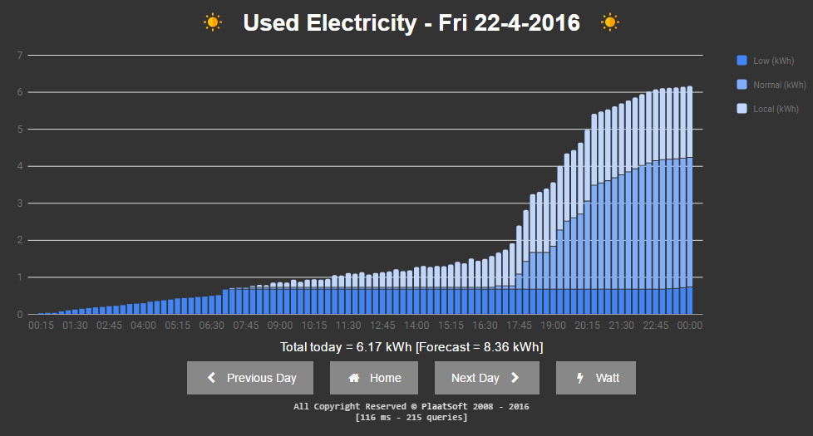

Slide 17
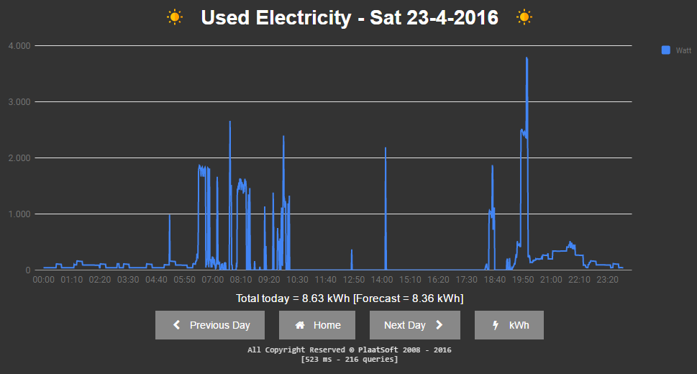

Slide 18
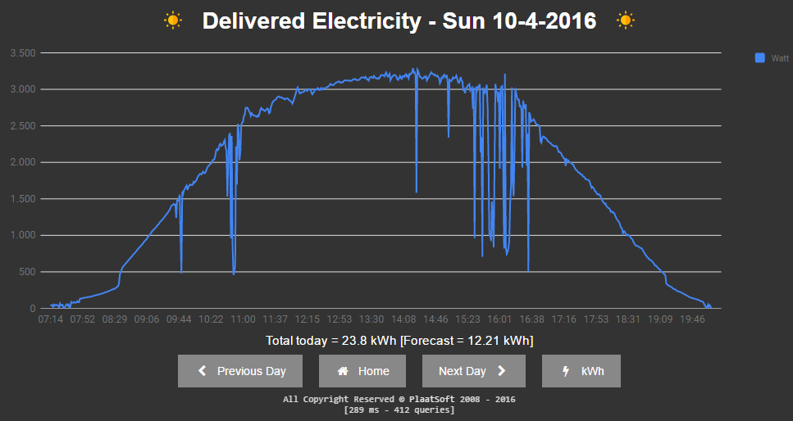

Slide 19
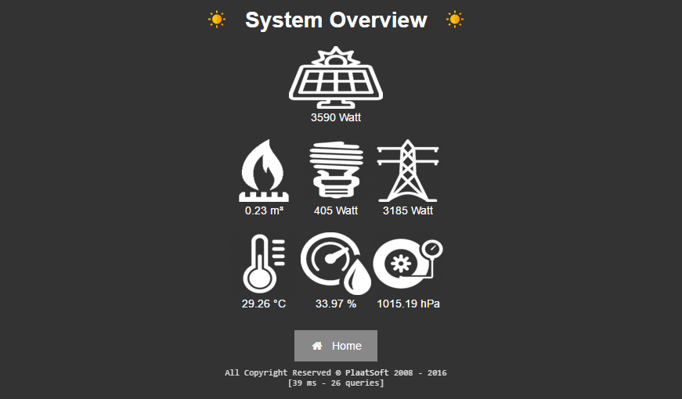

Slide 20


Slide 21
Conclusion
My energy consumption is dropped with 25%
My gas consumption is dropped with 50%
Reason: I am more aware now.
PlaatEnergy is downloaded ca. 140 times “Customers” sending great feedback back ☺
SOS Solutions. One of the biggest Raspberry Pi resellers in the Netherlands will sell soon a Pi Smart Energy Kit with includes PlaatEnergy ☺

Slide 22

More info
visit
plaatsoft.nl

